Slide 1

Lecture 12:
Research Software Engineering & Open science
CoTaPP: Computational Thinking and
Programming with Python
All icons by: https://www.flaticon.com/

Slide 2

Today’s lecture
Midterm review
Licenses
Research Software Engineering
Open Science
Tools / Concepts

Slide 3


Slide 4




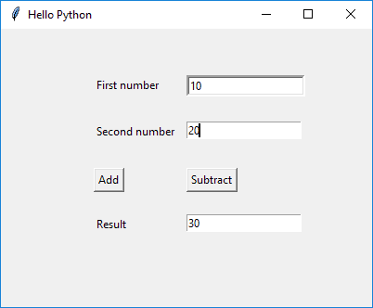

Slide 5





Slide 6


Slide 7
Licenses
Copyright
  “Copyright (or author’s right) is a legal term used to describe the rights that creators have over their literary and artistic works. Works covered by copyright range from books, music, paintings, sculpture, and films, to computer programs, databases, advertisements, maps, and technical drawings” (WIPO)
If a work has copyright, you need to ask how you can use it
https://www.wipo.int/copyright/en/#:~:text=Copyright%20(or%20author's%20right)%20is,%2C%20maps%2C%20and%20technical%20drawings.

Slide 8
Open Source License
Open source licenses are licenses that allow software to be freely used, modified, and shared under defined terms and conditions

Slide 9
Open Source License
Popular Licenses
  Apache License 2.0
  BSD 3-Clause "New" or "Revised" license
  BSD 2-Clause "Simplified" or "FreeBSD" license
  GNU General Public License (GPL)
  GNU Library or "Lesser" General Public License (LGPL)
  MIT license
  Mozilla Public License 2.0
  Common Development and Distribution License
  Eclipse Public License version 2.0
https://opensource.org/licenses

Slide 10
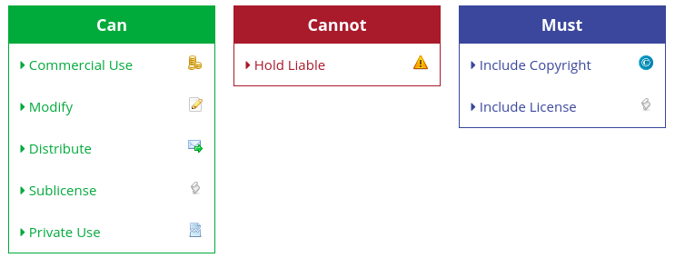
The MIT License
“Coffee Partner Lottery” from Project 3 has a MIT License
https://tldrlegal.com/

Slide 11
The MIT Licence
Begin license text.
Copyright <YEAR> <COPYRIGHT HOLDER>
Permission is hereby granted, free of charge, to any person obtaining a copy of this software and associated documentation files (the "Software"), to deal in the Software without restriction, including without limitation the rights to use, copy, modify, merge, publish, distribute, sublicense, and/or sell copies of the Software, and to permit persons to whom the Software is furnished to do so, subject to the following conditions:
The above copyright notice and this permission notice shall be included in all copies or substantial portions of the Software.
THE SOFTWARE IS PROVIDED "AS IS", WITHOUT WARRANTY OF ANY KIND, EXPRESS OR IMPLIED, INCLUDING BUT NOT LIMITED TO THE WARRANTIES OF MERCHANTABILITY, FITNESS FOR A PARTICULAR PURPOSE AND NONINFRINGEMENT. IN NO EVENT SHALL THE AUTHORS OR COPYRIGHT HOLDERS BE LIABLE FOR ANY CLAIM, DAMAGES OR OTHER LIABILITY, WHETHER IN AN ACTION OF CONTRACT, TORT OR OTHERWISE, ARISING FROM, OUT OF OR IN CONNECTION WITH THE SOFTWARE OR THE USE OR OTHER DEALINGS IN THE SOFTWARE.
End license text.

Slide 12
Software Licenses in Plain English
https://tldrlegal.com/

Slide 13
Creative Commons license
Creative Commons (CC) licenses are public licenses. You can use them to indicate what other people are allowed to do with your work
You can use them to any “work” that you produce, not only software

Slide 14
Research Software Engineering

Slide 15
Research Software Engineering
Research software engineering is the use of software engineering practices in research applications (Wikipedia)

Slide 16
Research Software Engineering
Research software engineering is the use of software engineering practices in research applications (Wikipedia).
→ Write software for your research

Slide 17
Research Software Engineering
Research software engineering is the use of software engineering practices in research applications (Wikipedia).
→ Write software for your research
→ You have the basis to write software for your research or at least engage in discussion with your team

Slide 18
Version control and code collaboration
Source: https://www.nobledesktop.com/blog/what-is-git-and-why-should-you-use-it

Slide 19
Version control and code collaboration
Git
  Is the most commonly used version control system
Source: https://www.nobledesktop.com/blog/what-is-git-and-why-should-you-use-it

Slide 20
Version control and code collaboration
Git
  Is the most commonly used version control system
  It tracks the changes you make to files, so you have a record of what has been done, and you can revert to specific versions should you ever need to
Source: https://www.nobledesktop.com/blog/what-is-git-and-why-should-you-use-it

Slide 21
Version control and code collaboration
Git
  Is the most commonly used version control system
  It tracks the changes you make to files, so you have a record of what has been done, and you can revert to specific versions should you ever need to
  It also makes collaboration easier, allowing changes by multiple people to all be merged into one source
Source: https://www.nobledesktop.com/blog/what-is-git-and-why-should-you-use-it

Slide 22

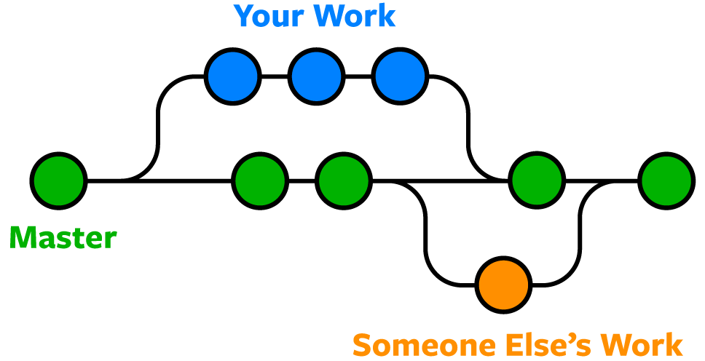


Version control and code collaboration
Source: https://www.nobledesktop.com/blog/what-is-git-and-why-should-you-use-it

Slide 23
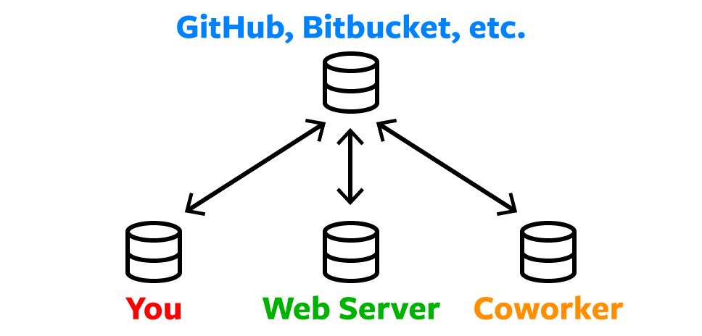
Remote Repositories
Source: https://www.nobledesktop.com/blog/what-is-git-and-why-should-you-use-it

Slide 24
Version control and code collaboration
Github
Source: https://www.coursereport.com/blog/what-is-github

Slide 25
Version control and code collaboration
Github
  “Coffee Partner Lottery” from Project 3 is shared on GitHub
Source: https://www.coursereport.com/blog/what-is-github

Slide 26
Version control and code collaboration
Github
  “Coffee Partner Lottery” from Project 3 is shared on GitHub
  GitHub, is a web application that hosts Git repositories.
Source: https://www.coursereport.com/blog/what-is-github

Slide 27
Version control and code collaboration
Github
  “Coffee Partner Lottery” from Project 3 is shared on GitHub
  GitHub, is a web application that hosts Git repositories.
  Private vs Public repositories
Source: https://www.coursereport.com/blog/what-is-github

Slide 28
Version control and code collaboration
Github
  “Coffee Partner Lottery” from Project 3 is shared on GitHub
  GitHub, is a web application that hosts Git repositories.
  Private vs Public repositories
  You can share your code, others can make modifications
Source: https://www.coursereport.com/blog/what-is-github

Slide 29
Version control and code collaboration
Github
  “Coffee Partner Lottery” from Project 3 is shared on GitHub
  GitHub, is a web application that hosts Git repositories.
  Private vs Public repositories
  You can share your code, others can make modifications.
  It is a data repository that can be used for Open Science
Source: https://www.coursereport.com/blog/what-is-github

Slide 30
Open Science

Slide 31
What is open science?
Open Science is the movement that aims at more open and collaborative research practices in which publications, data, software and other types of academic output are shared at the earliest possible stage and made available for reuse
https://www.nwo.nl/en/open-science

Slide 32
Discussion
Why is open science a good idea?
Can open science be applied in your field of study?
Can you think and give an example of how to apply open science in your field of study?
Does open science apply only to academic research? Or also to companies?

Slide 33
Publishing open access (OA)
https://authorservices.taylorandfrancis.com/publishing-open-access/oa-green-gold/

Slide 34
Publishing open access (OA)
Closed access:
  is the traditional form of scientific publishing. You can share article copies privately, but may not make them public
Gold open access
Publications are free for everybody Usually you need to pay the publisher.
Green open access
Also known as self-archiving
Post an earlier version of your manuscript (preprint) in repositories and online
https://authorservices.taylorandfrancis.com/publishing-open-access/oa-green-gold/

Slide 35
Publishing open access (OA)
Closed access:
  is the traditional form of scientific publishing. You can share article copies privately, but may not make them public
Gold open access
  Publications are free for everybody. Usually you need to pay the publisher
Green open access
Also known as self-archiving
Post an earlier version of your manuscript (preprint) in repositories and online
https://authorservices.taylorandfrancis.com/publishing-open-access/oa-green-gold/

Slide 36
Publishing open access (OA)
Closed access:
  is the traditional form of scientific publishing. You can share article copies privately, but may not make them public
Gold open access
  Publications are free for everybody. Usually you need to pay the publisher
Green open access
  Also known as self-archiving
  Post an earlier version of your manuscript (preprint) in repositories and online
https://authorservices.taylorandfrancis.com/publishing-open-access/oa-green-gold/

Slide 37
Preprint repositories
arXiv – Launched in 1991 this is the oldest and best-known paper preprint server. Fields of computer science, mathematics and physics.
ChemRxiv – a preprint sever for papers in chemistry.
BioRxiv – for preprints of research in biology and life sciences.
MedRxiv – preprints in health sciences
PsyArXiv – preprint server for papers in psychology
RePEc – preprints in economics
SocArXiv – preprints in social sciences
https://peerrecognized.com/open-science/

Slide 38
Open Data
Data repositories for storing and sharing research data, code, and methodology
General repositories
Zenodo: A general-purpose open-access repository developed under the European OpenAIRE program and operated by CERN.
Specific repositories
UniProtKB: Protein sequences
Data Repository Guidance: https://www.nature.com/sdata/policies/repositories
https://peerrecognized.com/open-science/

Slide 39
Open Data
Data repositories for storing and sharing research data, code, and methodology
General repositories
  Zenodo: A general-purpose open-access repository developed under the European OpenAIRE program and operated by CERN.
Specific repositories
UniProtKB: Protein sequences
Data Repository Guidance: https://www.nature.com/sdata/policies/repositories
https://peerrecognized.com/open-science/

Slide 40
Open Data
Data repositories for storing and sharing research data, code, and methodology
General repositories
  Zenodo: A general-purpose open-access repository developed under the European OpenAIRE program and operated by CERN.
Specific repositories
  UniProtKB: Protein sequences
Data Repository Guidance: https://www.nature.com/sdata/policies/repositories
https://peerrecognized.com/open-science/

Slide 41

https://www.youtube.com/watch?v=7xNGVzlG11o

Slide 42
To Do
This lecture doesn’t have exercises on quarterfall
Lab: work on Project 3

